Slide 1
Q1
Quarterly Market Review
First Quarter 2024
135202

Slide 2
Quarterly Market Review
First quarter 2024
This report features world capital market performance and a timeline of events for the past quarter. It begins with a global overview, then features the returns of stock and bond asset classes in the US and international markets. The report concludes with a quarterly topic.
Overview:
Market Summary
World Stock Market Performance
US Stocks
International Developed Stocks
Emerging Markets Stocks
Fixed Income
Quarterly Topic: The Next BlackBerry?
135210

Slide 3
Quarterly Market Summary
Index returns
 | US Stock Market | International Developed Stocks | Emerging Markets Stocks | Global Real Estate |  | US Bond Market | Global Bond Market ex US
Q1 2024 | STOCKS |  |  |  |  | BONDS
 | 10.02% | 5.59% | 2.37% | -1.19% |  | -0.78% | 0.58%
Since Jan. 2001
Average Quarterly Return | 2.4% | 1.6% | 2.5% | 2.2% |  | 0.9% | 0.9%
Best | 22.0% | 25.9% | 34.7% | 32.3% |  | 6.8% | 5.4%
Quarter | 2020 Q2 | 2009 Q2 | 2009 Q2 | 2009 Q3 |  | 2023 Q4 | 2023 Q4
Worst | -22.8% | -23.3% | -27.6% | -36.1% |  | -5.9% | -4.1%
Quarter | 2008 Q4 | 2020 Q1 | 2008 Q4 | 2008 Q4 |  | 2022 Q1 | 2022 Q1
Past performance is not a guarantee of future results. Indices are not available for direct investment. Index performance does not reflect the expenses associated with the management of an actual portfolio.
Market segment (index representation) as follows: US Stock Market (Russell 3000 Index), International Developed Stocks (MSCI World ex USA Index [net dividends]), Emerging Markets (MSCI Emerging Markets Index [net dividends]), Global Real Estate (S&P Global REIT Index [net dividends]), US Bond Market (Bloomberg US Aggregate Bond Index), and Global Bond Market ex US (Bloomberg Global Aggregate ex-USD Bond Index [hedged to USD]). S&P data © 2024 S&P Dow Jones Indices LLC, a division of S&P Global. All rights reserved. Frank Russell Company is the source and owner of the trademarks, service marks, and copyrights related to the Russell Indexes. MSCI data © MSCI 2024, all rights reserved. Bloomberg data provided by Bloomberg.
135211

Slide 4
Long-Term Market Summary
Index returns as of March 31, 2024
 | US Stock Market | International Developed Stocks | Emerging Markets Stocks | Global Real Estate |  | US Bond Market | Global Bond Market ex US
1 Year | STOCKS |  |  |  |  | BONDS
 | 29.29% | 15.29% | 8.15% | 7.44% |  | 1.70% | 5.92%
5 Years
 | 14.34% | 7.48% | 2.22% | 1.21% |  | 0.36% | 1.03%
10 Years
 | 12.33% | 4.81% | 2.95% | 3.89% |  | 1.54% | 2.64%
Past performance is not a guarantee of future results. Indices are not available for direct investment. Index performance does not reflect the expenses associated with the management of an actual portfolio.
Market segment (index representation) as follows: US Stock Market (Russell 3000 Index), International Developed Stocks (MSCI World ex USA Index [net dividends]), Emerging Markets (MSCI Emerging Markets Index [net dividends]), Global Real Estate (S&P Global REIT Index [net dividends]), US Bond Market (Bloomberg US Aggregate Bond Index), and Global Bond Market ex US (Bloomberg Global Aggregate ex-USD Bond Index [hedged to USD]). S&P data © 2024 S&P Dow Jones Indices LLC, a division of S&P Global. All rights reserved. Frank Russell Company is the source and owner of the trademarks, service marks, and copyrights related to the Russell Indexes. MSCI data © MSCI 2024, all rights reserved. Bloomberg data provided by Bloomberg.
135212

Slide 5
World Stock Market Performance
MSCI All Country World Index with selected headlines from Q1 2024
1 year (Q2 2023–Q1 2024)
Last 3 months
Q1 2024
“S&P 500 Closes at First Record High in Two Years as Tech Fuels US Stocks”
“Eurozone Industrial Production Unexpectedly Expands amid Signs Recovery for Sector”
“Markets around the World Set Records in First Quarter”
“Gold Rallies to All-Time High”
“Global Era of Negative Interest Rates Ends as Japan Goes to Zero”
“US Inflation Edged Up in December after Rapid Cooling Most of 2023”
“US Treasury Yields Rise in February as Fed Pivot Is Delayed”
“US Border Deal Is Declared Dead”
“US Durable-Goods Orders Rebound and Business Investment Rises”
“US Small-Business Optimism Weakens on Inflation Worries”
“China Becomes the World’s Biggest Auto Exporter”
“Dow, S&P 500, Nikkei Surge to Records after Nvidia’s Blockbuster Earnings Spark Global Rally”
“US Jobs Growth of 353,000 Blasts Past Expectations as Labor Market Stays Hot”
“Fed Minutes Suggest Rate Hikes Are Over, but Offer No Timetable on Cuts”
“Pentagon Runs Out of Congressionally Appropriated Funds for Ukraine”
“UK Retail Rebound Promises Quick Route Out of Recession”
“US Unemployment Ticks Higher to 3.9% and Wage Growth Slows”
“US Senate Approves Measure Averting Government Shutdown”
These headlines are not offered to explain market returns. Instead, they serve as a reminder that investors should view daily events from a long-term perspective and avoid making investment decisions based solely on the news.
Graph Source: MSCI ACWI Index (net dividends). MSCI data © MSCI 2024, all rights reserved. Index level based at 100 starting January 2000. It is not possible to invest directly in an index. Performance does not reflect the expenses associated with management of an actual portfolio. Past performance is not a guarantee of future results.
135213

Slide 6
World Stock Market Performance
MSCI All Country World Index with selected headlines from past 12 months
Long Term (2000–Q1 2024)
Short Term (Q2 2023–Q1 2024)
Last 12 months
“Bitcoin Funds Pull In Money at Record Pace”
“Israel Declares War on Hamas after Surprise Assault from Gaza”
“S&P 500 Ends Strong Year Just Shy of Record with 24% Annual Gain”
“Markets around the World Set Records in First Quarter”
“Nasdaq Closes at 14-Month High as Small Cap Stocks Rally”
“Dow, S&P 500, Nikkei Surge to Records after Nvidia’s Blockbuster Earnings Spark Global Rally”
“S&P 500 Hits 2023 High as Attention Grows on Debt-Ceiling Deal”
“US Mortgage Rates Hit 7.09%, Highest in More Than 20 Years”
“Job Openings Fall to 28-Month Low as US Labor Market Cools”
“WHO Declares COVID-19 Pandemic Emergency Over”
“Fitch Slashes US Credit Rating to AA+ from AAA”
“Nasdaq Exits Correction Territory; Small Caps See Best Day in More than a Year”
“US Border Deal Is Declared Dead”
“US Senate Approves Measure Averting Government Shutdown”
“US Inflation Eased to 5% in March; Lowest Level in Nearly Two Years”
“Turkey Agrees to Let Sweden In NATO”
“US House Elects Speaker, Ends Impasse”
“US Inflation Edged Up in December after Rapid Cooling Most of 2023”
These headlines are not offered to explain market returns. Instead, they serve as a reminder that investors should view daily events from a long-term perspective and avoid making investment decisions based solely on the news.
Graph Source: MSCI ACWI Index (net dividends). MSCI data © MSCI 2024, all rights reserved. Index level based at 100 starting January 2000. It is not possible to invest directly in an index. Performance does not reflect the expenses associated with management of an actual portfolio. Past performance is not a guarantee of future results.
135214

Slide 7
US Stocks
First quarter 2024 index returns
The US equity market posted positive returns for the quarter and outperformed both non-US developed and emerging markets.
Value underperformed growth.
Small caps underperformed large caps.
REIT indices underperformed equity market indices.
Ranked Returns (%)
World Market Capitalization—US
Period Returns (%)
 |  |  | Annualized | * Annualized
Asset Class | QTR | 1 Year | 3 Years | 5 Years | 10 Years
Large Growth | 11.41 | 39.00 | 12.50 | 18.52 | 15.98
Large Cap | 10.30 | 29.87 | 10.45 | 14.76 | 12.68
Marketwide | 10.02 | 29.29 | 9.78 | 14.34 | 12.33
Large Value | 8.99 | 20.27 | 8.11 | 10.32 | 9.01
Small Growth | 7.58 | 20.35 | -2.68 | 7.38 | 7.89
Small Cap | 5.18 | 19.71 | -0.10 | 8.10 | 7.58
Small Value | 2.90 | 18.75 | 2.22 | 8.17 | 6.87
Past performance is not a guarantee of future results. Indices are not available for direct investment. Index performance does not reflect the expenses associated with the management of an actual portfolio. Market segment (index representation) as follows: Marketwide (Russell 3000 Index), Large Cap (Russell 1000 Index), Large Value (Russell 1000 Value Index), Large Growth (Russell 1000 Growth Index), Small Cap (Russell 2000 Index), Small Value (Russell 2000 Value Index), and Small Growth (Russell 2000 Growth Index). World Market Cap represented by Russell 3000 Index, MSCI World ex USA IMI Index, and MSCI Emerging Markets IMI Index. Russell 3000 Index is used as the proxy for the US market. Dow Jones US Select REIT Index used as proxy for the US REIT market. MSCI data © MSCI 2024, all rights reserved. Frank Russell Company is the source and owner of the trademarks, service marks, and copyrights related to the Russell Indexes.
135215

Slide 8
International Developed Stocks
Firm Logo
First quarter 2024 index returns
Developed markets outside of the US posted positive returns for the quarter and underperformed the US market, but outperformed emerging markets.
Value underperformed growth.
Small caps underperformed large caps.
Ranked Returns (%)
Value
Large Cap
Growth
Small Cap
World Market Capitalization—International Developed
Period Returns (%)
 |  |  | Annualized | * Annualized
Asset Class | QTR | 1 Year | 3 Years | 5 Years | 10 Years
Growth | 6.91 | 13.66 | 2.83 | 7.86 | 5.74
Large Cap | 5.59 | 15.29 | 4.93 | 7.48 | 4.81
Value | 4.22 | 16.90 | 6.80 | 6.62 | 3.61
Small Cap | 2.58 | 10.04 | -0.93 | 5.39 | 4.54
Past performance is not a guarantee of future results. Indices are not available for direct investment. Index performance does not reflect the expenses associated with the management of an actual portfolio.
Market segment (index representation) as follows: Large Cap (MSCI World ex USA Index), Small Cap (MSCI World ex USA Small Cap Index), Value (MSCI World ex USA Value Index), and Growth (MSCI World ex USA Growth Index). All index returns are net of withholding tax on dividends. World Market Cap represented by Russell 3000 Index, MSCI World ex USA IMI Index, and MSCI Emerging Markets IMI Index. MSCI World ex USA IMI Index is used as the proxy for the International Developed market. MSCI data © MSCI 2024, all rights reserved. Frank Russell Company is the source and owner of the trademarks, service marks, and copyrights related to the Russell Indexes.
135216

Slide 9
Emerging Markets Stocks
First quarter 2024 index returns
Emerging markets posted positive returns for the quarter and underperformed both US and non-US developed markets.
Value underperformed growth.
Small caps underperformed large caps.
Ranked Returns (%)
World Market Capitalization—Emerging Markets
Period Returns (%)
 |  |  | Annualized | Annualized
Asset Class | QTR | 1 Year | 3 Years | 5 Years | 10 Years
Growth | 3.35 | 5.16 | -8.85 | 2.24 | 3.63
Large Cap | 2.37 | 8.15 | -5.05 | 2.22 | 2.95
Value | 1.31 | 11.36 | -0.91 | 2.09 | 2.15
Small Cap | 1.05 | 20.56 | 4.23 | 8.51 | 5.09
Past performance is not a guarantee of future results. Indices are not available for direct investment. Index performance does not reflect the expenses associated with the management of an actual portfolio. Market segment (index representation) as follows: Large Cap (MSCI Emerging Markets Index), Small Cap (MSCI Emerging Markets Small Cap Index), Value (MSCI Emerging Markets Value Index), and Growth (MSCI Emerging Markets Growth Index). All index returns are net of withholding tax on dividends. World Market Cap represented by Russell 3000 Index, MSCI World ex USA IMI Index, and MSCI Emerging Markets IMI Index. MSCI Emerging Markets IMI Index used as the proxy for the emerging market portion of the market. MSCI data © MSCI 2024, all rights reserved. Frank Russell Company is the source and owner of the trademarks, service marks, and copyrights related to the Russell Indexes.
135217

Slide 10
Fixed Income
First quarter 2024 index returns
Interest rates generally increased in the US Treasury market for the quarter.
On the short end of the yield curve, the 1-Month US Treasury Bill yield decreased 11 basis points (bps) to 5.49%, while the 1-Year US Treasury Bill yield increased 24 bps to 5.03%. The yield on the 2-Year US Treasury Note increased 36 bps to 4.59%.
The yield on the 5-Year US Treasury Note increased 37 bps to 4.21%. The yield on the 10-Year US Treasury Note increased 32 bps to 4.20%. The yield on the 30-Year US Treasury Bond increased 31 bps to 4.34%.
In terms of total returns, short-term US treasury bonds returned -0.05% while intermediate-term US treasury bonds returned -0.36%. Short-term corporate bonds returned +0.60% and intermediate-term corporate bonds returned +0.26%.¹
The total returns for short- and intermediate-term municipal bonds were -0.19% and -0.52%, respectively. Within the municipal fixed income market, general obligation bonds returned -0.70% while revenue bonds returned -0.27%.²
US Treasury Yield Curve (%)
Bond Yield Across Issuers (%)
Yield to Maturity
Yield to Worst
Period Returns (%)
 |  |  | Annualized | Annualized
Asset Class | QTR | 1 Year | 3 Years | 5 Years | 10 Years
Bloomberg U.S. High Yield Corporate Bond Index | 1.47 | 11.15 | 2.19 | 4.21 | 4.44
ICE BofA US 3-Month Treasury Bill Index | 1.29 | 5.24 | 2.58 | 2.02 | 1.38
ICE BofA 1-Year US Treasury Note Index | 0.83 | 4.30 | 1.44 | 1.66 | 1.25
FTSE World Government Bond Index 1-5 Years (hedged to USD) | 0.26 | 3.66 | 0.11 | 1.16 | 1.41
Bloomberg U.S. TIPS Index | -0.08 | 0.45 | -0.53 | 2.49 | 2.21
Bloomberg Municipal Bond Index | -0.39 | 3.13 | -0.41 | 1.59 | 2.66
Bloomberg U.S. Aggregate Bond Index | -0.78 | 1.70 | -2.46 | 0.36 | 1.54
FTSE World Government Bond Index 1-5 Years | -1.35 | 1.27 | -2.61 | -0.40 | -0.68
Bloomberg U.S. Government Bond Index Long | -3.24 | -6.03 | -8.01 | -2.77 | 1.25
1. Bloomberg US Treasury and US Corporate Bond Indices.
2. Bloomberg Municipal Bond Index.
One basis point (bps) equals 0.01%. Past performance is not a guarantee of future results. Indices are not available for direct investment. Index performance does not reflect the expenses associated with the management of an actual portfolio. Yield curve data from Federal Reserve. State and local bonds and the Yield to Worst are from the S&P National AMT-Free Municipal Bond Index. AAA-AA Corporates represent the ICE BofA US Corporates, AA-AAA rated. A-BBB Corporates represent the ICE BofA Corporates, BBB-A rated. Bloomberg data provided by Bloomberg. US long-term bonds, bills, inflation, and fixed income factor data © Stocks, Bonds, Bills, and Inflation (SBBI) Yearbook™, Ibbotson Associates, Chicago (annually updated work by Roger G. Ibbotson and Rex A. Sinquefield). FTSE fixed income indices © 2024 FTSE Fixed Income LLC, all rights reserved. ICE BofA index data © 2024 ICE Data Indices, LLC. S&P data © 2024 S&P Dow Jones Indices LLC, a division of S&P Global. All rights reserved. Bloomberg data provided by Bloomberg.
135206

Slide 11
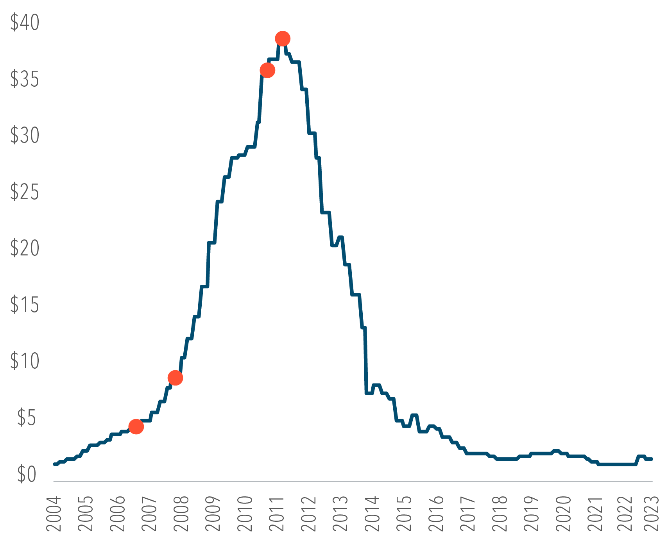
The Next BlackBerry?
First quarter 2024
Wes Crill, PhD, Senior Investment Director and Vice President, Dimensional Fund Advisors
Some investors attribute the Magnificent 7 stocks’ dominance to a “winner-take-all” environment in which a handful of companies achieve sufficient market share to hinder competition.¹ In businesses where gaining users drives success, establishing a strong market share may be like building a moat around profitability. But that doesn’t guarantee these companies can stay on top.
Think about the state of mobile phones 15 years ago. In all likelihood, you would have been reading this on a BlackBerry, such was that device’s entrenchment for mobile business communication. Then, along came iPhones and Androids and suddenly BlackBerry’s foothold was eroded.
History is littered with examples of household names that were usurped by the Next Big Thing. Remember, Sears was a Top 10-sized stock in the US once upon a time. AOL was synonymous with internet access in the 1990s. And in 2003, the most popular social media network starting with the letter F was Friendster.
Even the biggest companies have uncertain futures, highlighting the need for broadly diversified investments. And even if these companies stay at the top of the market, that’s no assurance higher returns will continue if their success is expected.
BLACKBERRY TRAILING 12-MONTH SALES PER SHARE
February 2004–January 2024
September 2011 $39.62
March 2011
Android Surpasses BlackBerry in US Smartphone Market Share
September 2008
Android Debut
June 2007
iPhone Debut
1. Magnificent 7 include Alphabet, Amazon, Apple, Meta, Microsoft, Nvidia, and Tesla. Named securities may be held in accounts managed by Dimensional.
See following page for important disclosure.
135208

Slide 12
The Next BlackBerry?
(continued from page 11)
Past performance is no guarantee of future results.
In USD. Source: FactSet.
Disclosures
The information in this material is intended for the recipient’s background information and use only. It is provided in good faith and without any warranty or representation as to accuracy or completeness. Information and opinions presented in this material have been obtained or derived from sources believed by Dimensional to be reliable, and Dimensional has reasonable grounds to believe that all factual information herein is true as at the date of this material. It does not constitute investment advice, a recommendation, or an offer of any services or products for sale and is not intended to provide a sufficient basis on which to make an investment decision. Before acting on any information in this document, you should consider whether it is appropriate for your particular circumstances and, if appropriate, seek professional advice. It is the responsibility of any persons wishing to make a purchase to inform themselves of and observe all applicable laws and regulations. Unauthorized reproduction or transmission of this material is strictly prohibited. Dimensional accepts no responsibility for loss arising from the use of the information contained herein.
This material is not directed at any person in any jurisdiction where the availability of this material is prohibited or would subject Dimensional or its products or services to any registration, licensing, or other such legal requirements within the jurisdiction.
“Dimensional” refers to the Dimensional separate but affiliated entities generally, rather than to one particular entity. These entities are Dimensional Fund Advisors LP, Dimensional Fund Advisors Ltd., Dimensional Ireland Limited, DFA Australia Limited, Dimensional Fund Advisors Canada ULC, Dimensional Fund Advisors Pte. Ltd., Dimensional Japan Ltd., and Dimensional Hong Kong Limited. Dimensional Hong Kong Limited is licensed by the Securities and Futures Commission to conduct Type 1 (dealing in securities) regulated activities only and does not provide asset management services.
RISKS
Investments involve risks. The investment return and principal value of an investment may fluctuate so that an investor’s shares, when redeemed, may be worth more or less than their original value. Past performance is not a guarantee of future results. There is no guarantee strategies will be successful.
Dimensional Fund Advisors LP is an investment advisor registered with the Securities and Exchange Commission.
Investment products: • Not FDIC Insured • Not Bank Guaranteed • May Lose Value
Dimensional Fund Advisors does not have any bank affiliates.
135209

